Slide 1


First order ordinary differential equations
REDUCEABLE TO SEPARABLE (HOMOGENEOUS EQUATION)
Integrating Factor

Slide 2


Slide 3
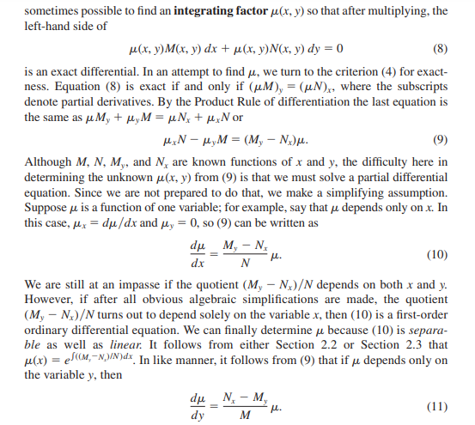

Slide 4
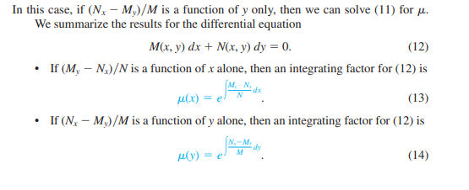

Slide 5
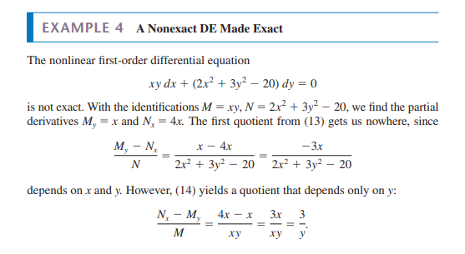

Slide 6


Slide 7
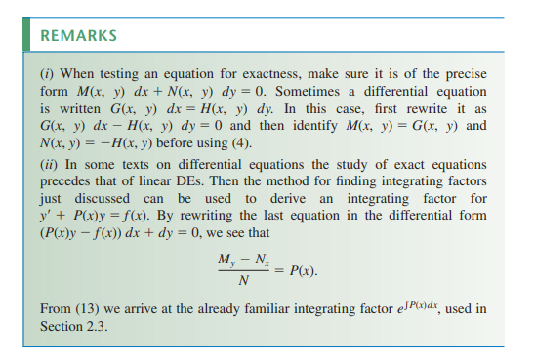

Slide 8
